Slide 1

基于.net core构建微服务
Ocelot篇
桂素伟

Slide 2
大纲
何为微服务
Ocelot网关
Ocelot统一验证
Ocelot监控
Ocelot+Consul负载均衡和容错保护

Slide 3
微服务
监控
告警
服务注册，发现
消息总线
日志
负载
均衡
？
API网关
容错
保护
分布式配置
……

Slide 4
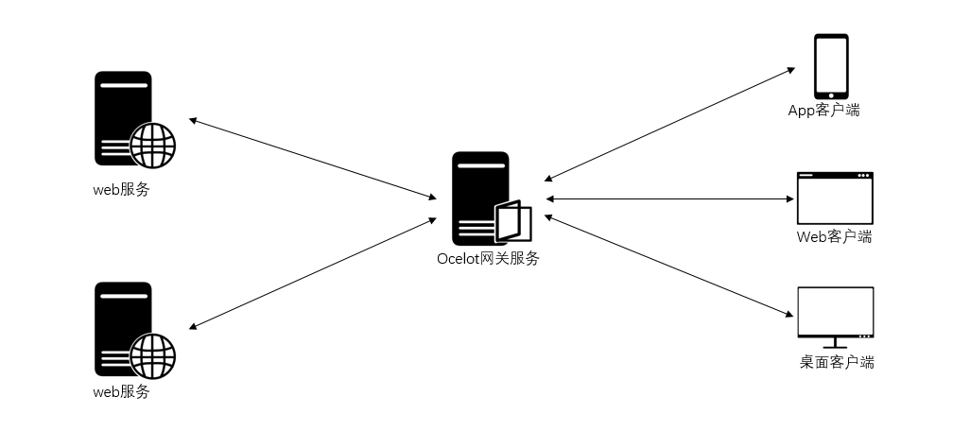
ocelot
https://github.com/TomPallister/Ocelot
Api网关，可以完成统一验证，监控等工作。

Slide 5
ocelot
Install-Package Ocelot
public static IWebHost BuildWebHost(string[] args)
{
IWebHostBuilder builder = new WebHostBuilder();
//注入WebHostBuilder
return builder.ConfigureServices(service =>
{
service.AddSingleton(builder);
})
//加载configuration配置文人年
.ConfigureAppConfiguration(conbuilder =>
{
conbuilder.AddJsonFile("configuration.json");
})
.UseKestrel()
.UseUrls("http://*:5000")
.UseStartup<Startup>()
.Build();
}

Slide 6
ocelot
public void ConfigureServices(IServiceCollection services)
{
//注入配置文件，AddOcelot要求参数是IConfigurationRoot类型，所以要作个转换
services.AddOcelot(Configuration as ConfigurationRoot);
}
public void Configure(IApplicationBuilder app, IHostingEnvironment env)
{
//添加中间件
app.UseOcelot().Wait();
}

Slide 7
ocelot
{
"ReRoutes": [
{
"DownstreamPathTemplate": "/demoaapi/values",
"DownstreamScheme": "http",
"DownstreamPort": 5001,
"DownstreamHost": "localhost",
"UpstreamPathTemplate": "/demoaapi/values",
"UpstreamHttpMethod": [ "Get" ],
"QoSOptions": {
"ExceptionsAllowedBeforeBreaking": 3,
"DurationOfBreak": 10,
"TimeoutValue": 5000
},
"HttpHandlerOptions": {
"AllowAutoRedirect": false,
"UseCookieContainer": false
},
"AuthenticationOptions": {
"AuthenticationProviderKey": "",
"AllowedScopes": []
}
},
{
"DownstreamPathTemplate": "/demobapi/values",
"DownstreamScheme": "http",
"DownstreamPort": 5002,
"DownstreamHost": "localhost",
"UpstreamPathTemplate": "/demobapi/values",
"UpstreamHttpMethod": [ "Get" ],
"QoSOptions": {
"ExceptionsAllowedBeforeBreaking": 3,
"DurationOfBreak": 10,
"TimeoutValue": 5000
},
"HttpHandlerOptions": {
"AllowAutoRedirect": false,
"UseCookieContainer": false
},
"AuthenticationOptions": {
"AuthenticationProviderKey": "",
"AllowedScopes": []
}
}
]
}

Slide 8
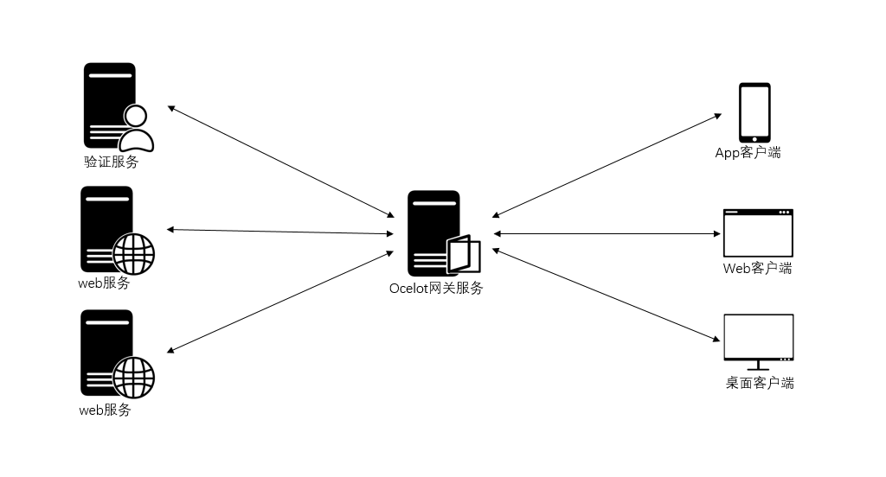
ocelot

Slide 9
Ocelot统一验证
统一验证Demo

Slide 10
Ocelot监控
InfluxDB
https://portal.influxdata.com/downloads
Grafana
https://grafana.com/get

Slide 11
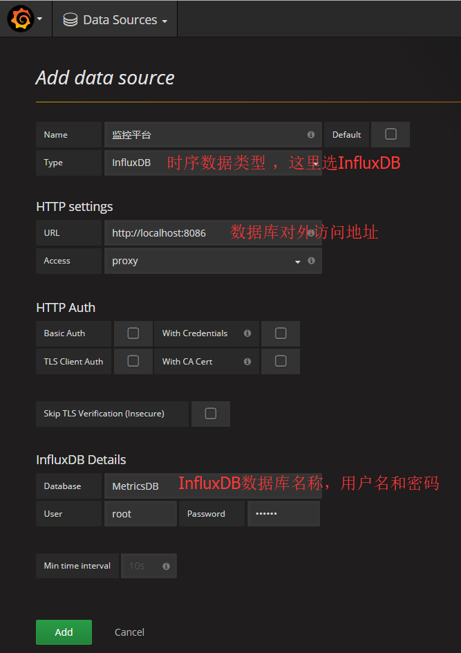
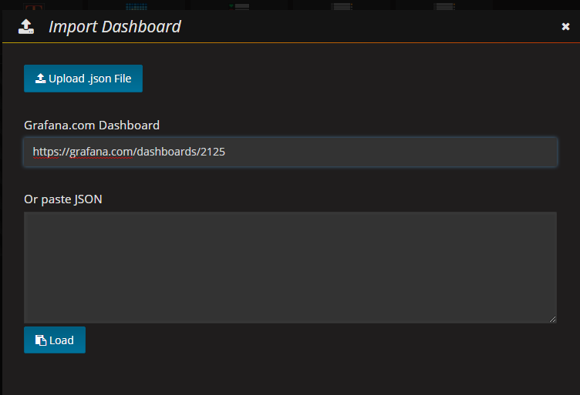
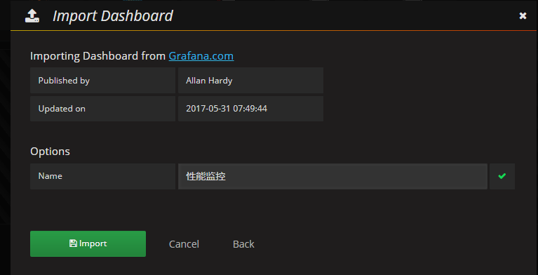
Ocelot监控
1、创建InfluxDB数据库
2、配置Grafana，然后启动网关程序，登录localhost:3000查看监控信息，用户名密码是：admin

Slide 12
Ocelot负载均衡和容错保护
"DownstreamPathTemplate": "/lisapi/lisuser",
"DownstreamScheme": "http",
"DownstreamHost": "localhost",
"DownstreamPort": 5002,
"UpstreamPathTemplate": "/lisapi/lisuser",
"UpstreamHttpMethod": [ "Get", "Post" ],
"ServiceName": "lisapi",
"LoadBalancer": "LeastConnection",
"UseServiceDiscovery": true,
"ReRouteIsCaseSensitive": false,
"QoSOptions": {
"ExceptionsAllowedBeforeBreaking": 3,
"DurationOfBreak": 10,
"TimeoutValue": 5000
},
"HttpHandlerOptions": {
"AllowAutoRedirect": false,
"UseCookieContainer": false
},
"AuthenticationOptions": {
"AuthenticationProviderKey": "GSWBearer",
"AllowedScopes": []
}
},
"GlobalConfiguration": {
"ServiceDiscoveryProvider": {
"Host": "localhost",
"Port": 8500
}
}

Slide 13
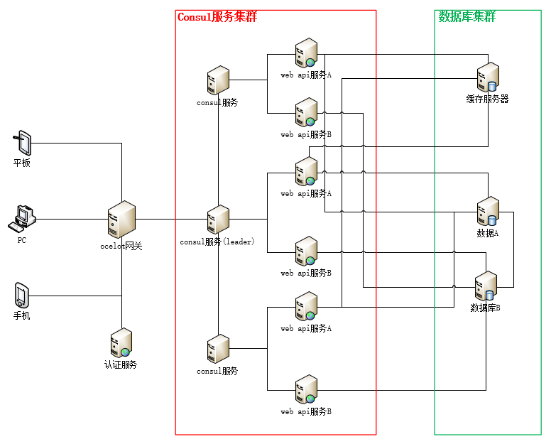
架构

Slide 14
Docker生成镜像和运行
代理地址：http://0522f34d.m.daoc
业务服务生成镜像
docker build -t lisapi:latest .
业务服务镜像运行 docker run -it -p 5002:5002 lisapi:latest
build consul镜像 docker build -t gliderlabs/consul-server:$('1.0.2') . 运行consul镜像 docker run -p 8500:8500 --name hisconsul -d gliderlabs/consul-server:1.0.2

Slide 15

Thank You!

